Slide 1
Math analysis
Day 59

Slide 2
Major Project Groups
Bryan High School:
Emily, Nicole, Patrik, Adriana, Fernando
Town:
Jakob, Alyssa, Pieter
Pagoda Village:
Stephen, Gerardo, Noah
Fort Nite:
Dylan, Sam, Faith
Zoo:
Edwin, Crystal, Yamile, Francisco
Castle from Fire Emblem Heros
Pedro, Truman, Michael
Dragon Ball - Moises
Fort Nite:
Jesse, Cole, Austin, Kemari

Slide 3
Objective/To Do for Today
Mini Presentation start in 20-30 minutes
Pictures of your rendered code
Describe the role of each member on your team
Give us your biggest obstacle holding you back at this point
Explanation of your process to this point
Explanation of your plan for after spring break
- Daily Log Reflection (2 week write up due)
- Set clear goals for your first day back from Spring Break so we know where to pick up after taking a week off
- Submit most up to date code on Teams

Slide 4
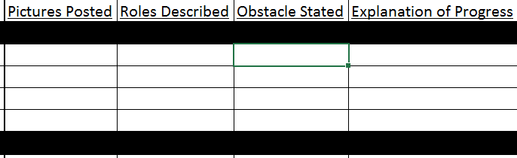
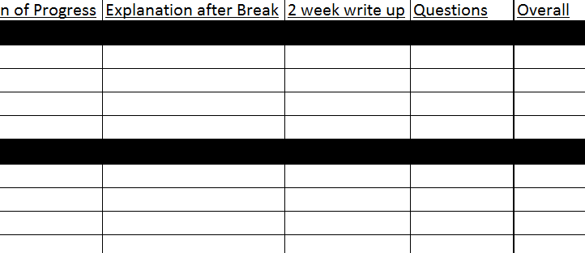

Slide 5
Daily One on One’s With Mr. Cuddy
Download LDraw if you don’t have it already…
Bricklayer.org → apps → bricklayer → windows
Keep posting in Trello and/or TEAMS your progress.
Mini Presentation and Daily Log two week write up due before spring break!
Post your code on TEAMS!!

Slide 6
Daily Log Reflection
What did I accomplish last time?
What did we accomplish last time?
Did we meet yesterdays goals?
What do we need to catch up on today?
What are my goals for today?
What are our goals for today?
Did we meet todays goals?

Slide 7
Daily Logs Expanded: 2 week write ups
Formative Daily Write Grade
Organize your daily write ups, either as bullet point sentences or a summary paragraph(s)

Slide 8
Deadlines (submit to folder on teams)
Week 1: Assign Roles, Set Scale, Rough Draft on Paper
Week 2: Begin coding initial functions
Week 3: Continue to code _______
Week 4: Mini Presentation, CLEAR GOALS for after SB
Week 5: SPRING BREAK
Week 6: ____[insert plan that will done] ____
Week 9:
Week 10: Finalize Code, Begin to Put Presentation together

